Slide 1
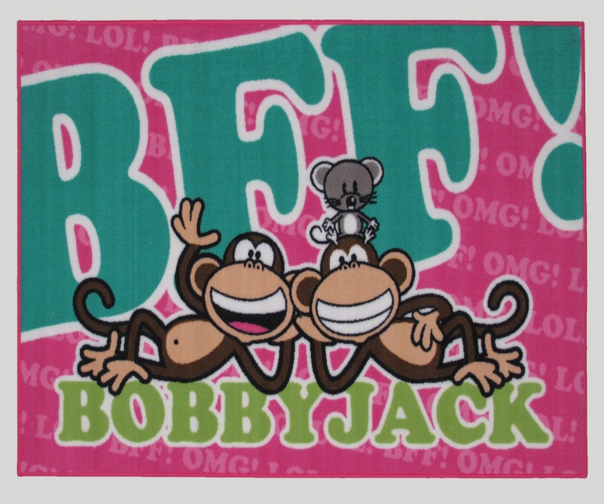
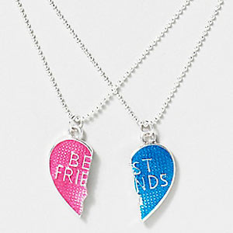
My Best Friend Hailey Hutchinson
Written by Zalaa Afzal

Slide 2
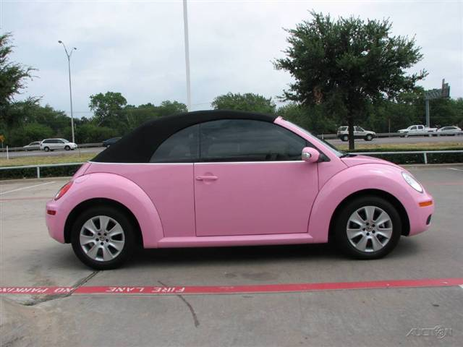
If my best friend were a car, she would be a Bug because she is pretty funny.

Slide 3
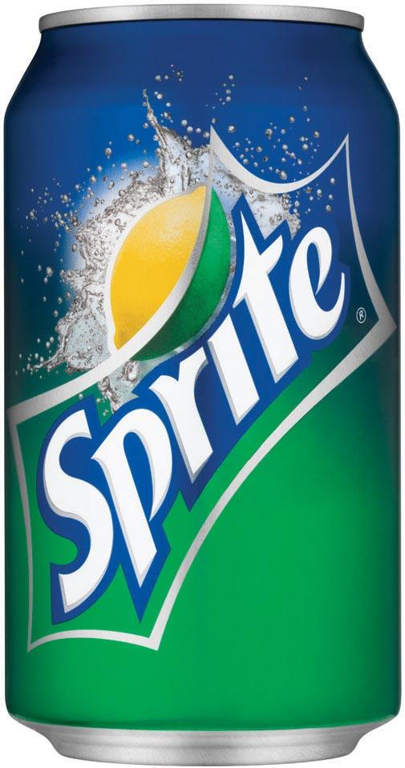
If my best friend were a soft drink, she would be a Sprite, because she is shiny cute and sparkly.

Slide 4
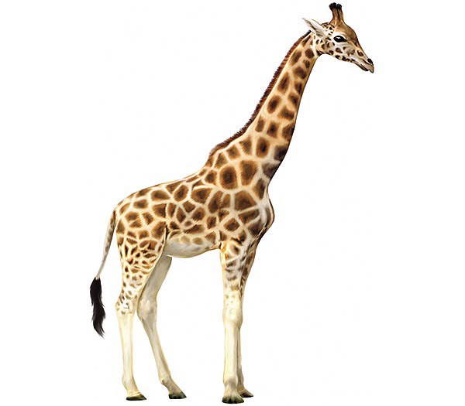
If my best friend were a zoo animal she would be a giraffe, because she is tall and cute.

Slide 5
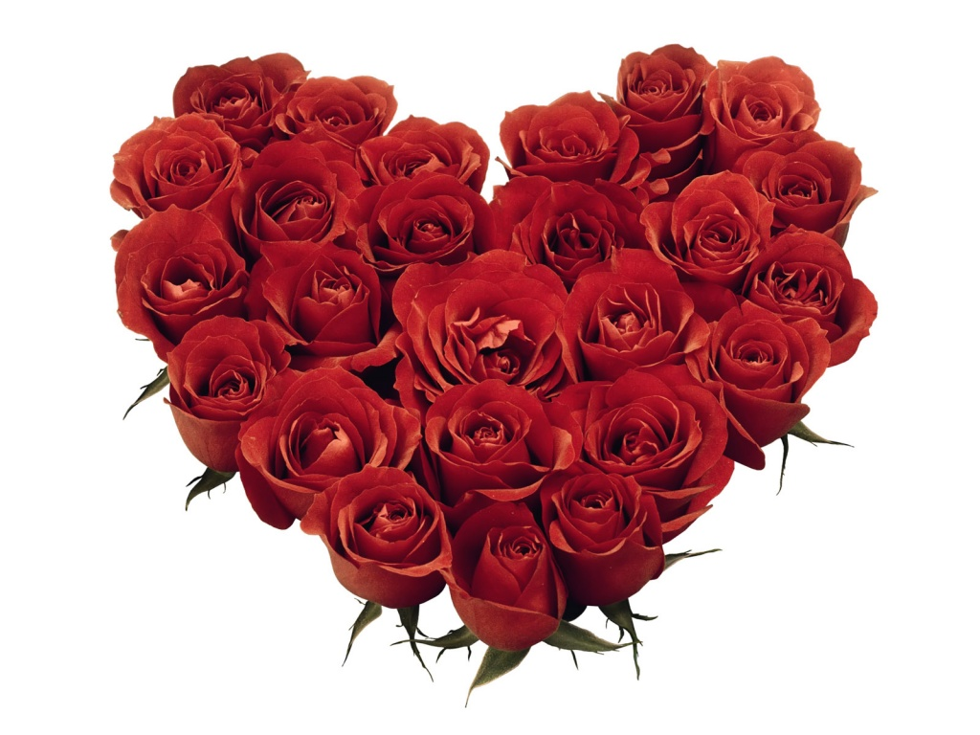
If my best friend were a ringtone, she would be “Jar of Hearts,” because she is kind.

Slide 6
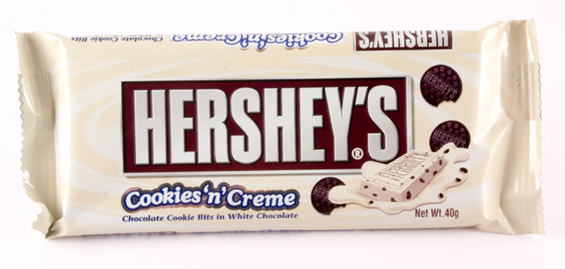
If my best friend were a candy, she would be a Hershey bar, because she is sweet.

