Slide 1
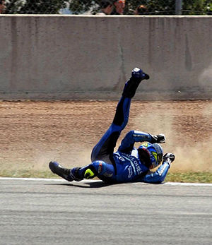
My Best Friend: Mark
Written by Tristan Dooley

Slide 2
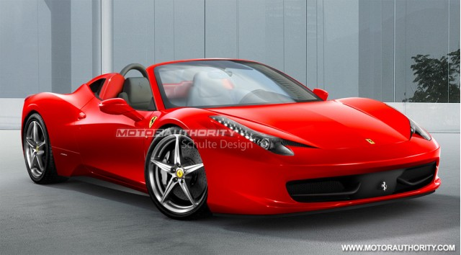
If my best friend were a car he would be a Ferrari, because he is fast and because he likes to race.

Slide 3
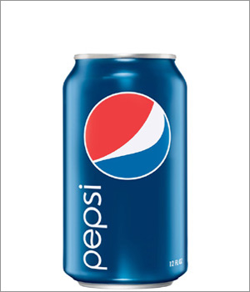
If my best friend were a soft drink he would be a Pepsi, because it has a lot of caffeine and he is really fast.

Slide 4
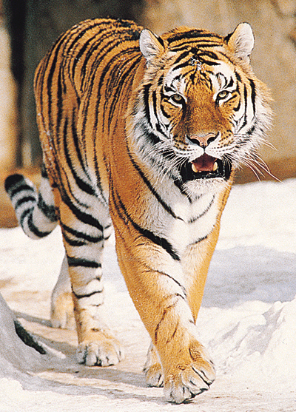
If my best friend were a zoo animal, he would be a tiger because he is fast.

Slide 5
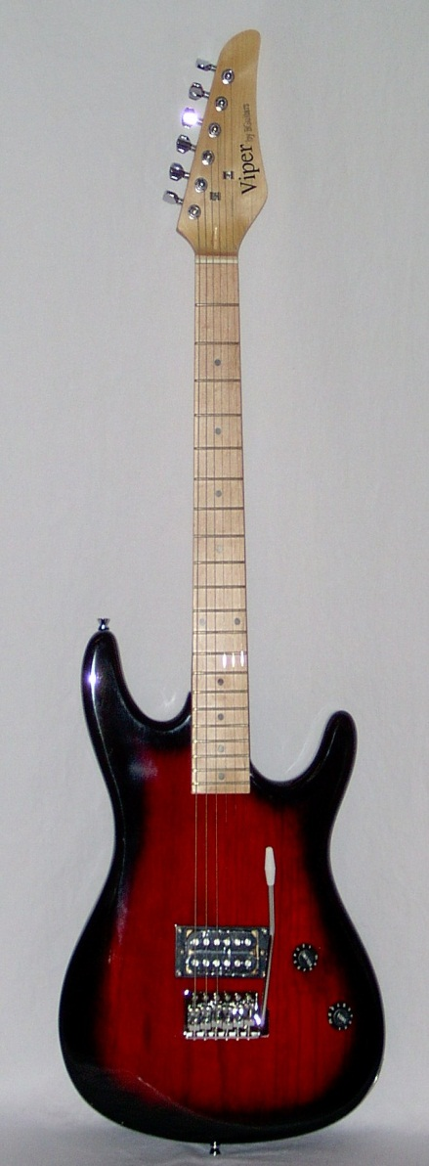
If my best friend were a ringtone he would be a rock an roll ring, because he talks loud.

Slide 6
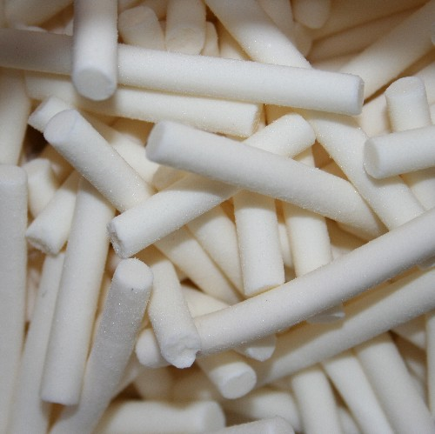
If my best friend were a candy he would be a chalk candy, because he is thin.

