Slide 1
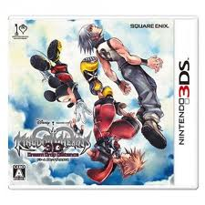
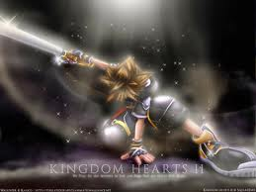
My Best Friend: Ahmed Seely
Written by Tanner burwell - lovitt

Slide 2
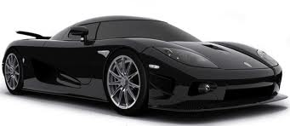
If my best friend was a car he would be a Lamborghini because he is runs really fast.

Slide 3
If my best friend was a soft drink he would be rootbeer because he is like the dog on the mug sign.

Slide 4
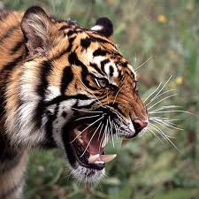
If my best friend was a zoo animal he would be a Tiger because when we play around with toy guns he likes to hunt his prey.
Please Note:
-Font:
Size 32+/Bold
-Layout:
Title Only

Slide 5
If my best friend was a ringtone he would be not afraid by eminem because he is fearless.

Slide 6
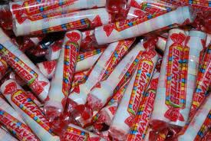
If my best friend was a candy he would be smarties because he gets really good grades.

