Slide 1
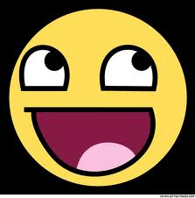
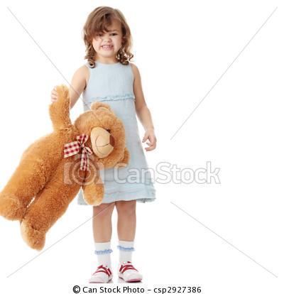
My best friend : my little sister! My Best Friend: My Sister
BY: NICOLE SAFTY
BBB===

Slide 2
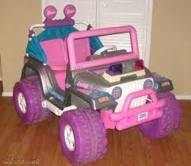
My little Sister is a “cutie pie” but enjoys video games as much as I do. So she's a purple high tech barbie car.

Slide 3
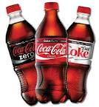
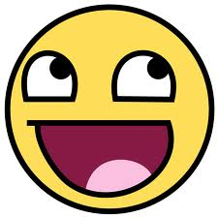
If my sister was a drink she would be Coke. Its sweet but it can slow you down. (Daniela is 5 so she hates Coke)

Slide 4
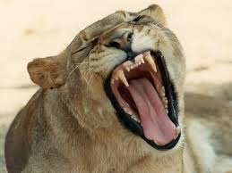
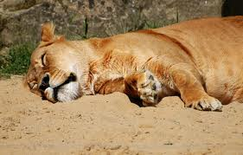
Daniela would be a blood curling lioness. She's adorable, yet deadly. But, she's lazy at the most. (mostly on walks)

Slide 5
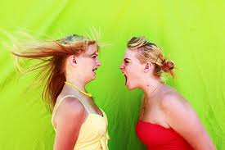
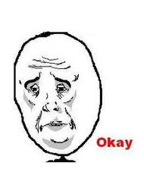
Daniela cant be any song. But she's a great mini ring tone that goes like this: PLAY WITH ME!

Slide 6
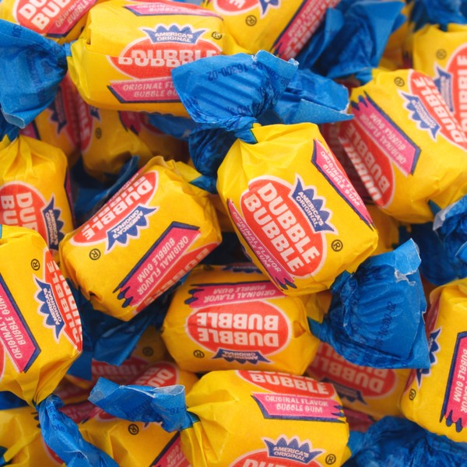
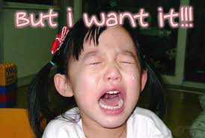
Daniela is a lot like gum. She has a lot of flavor at first but later, you'll get tired of the same flavor.

