Slide 1
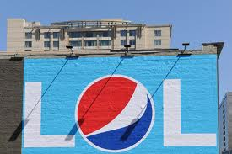
My Best Friend Katie
By: Nicole Safty

Slide 2
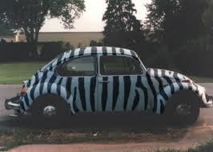
If Katie was a car she would be a zebra striped slug bug. When ever we are on trips she would always do that slug bug game.

Slide 3
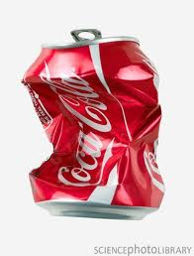
Katie is like Coke. She is sometimes energetic but she “looses the fizz.” Most of the times

Slide 4
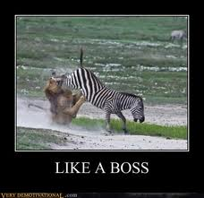
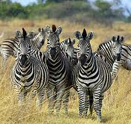
My best friend would be a zebra. Its her color and when a lion “ bully” grabs her she can always kick it in the face! :D

Slide 5
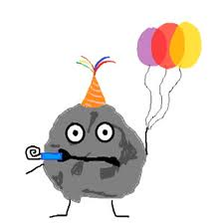
She is to hard to describe in song… maybe she could be “Party Rock Anthem” but she's to hard to describe.

Slide 6
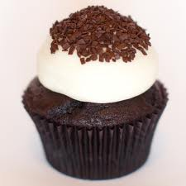
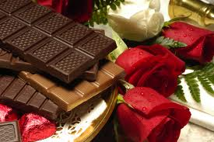
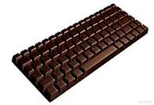
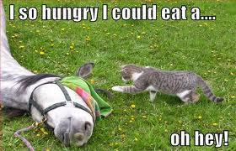
… Katie is a chocolate bar. Its sweet and nice. Its also chocolate HOW CAN YOU NOT LIKE CHOCLATE !?

