Slide 1
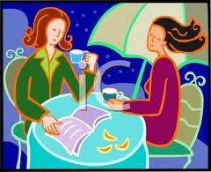
My Best Friend: Diana Alghaim
Written by
Manpreet Kaur

Slide 2
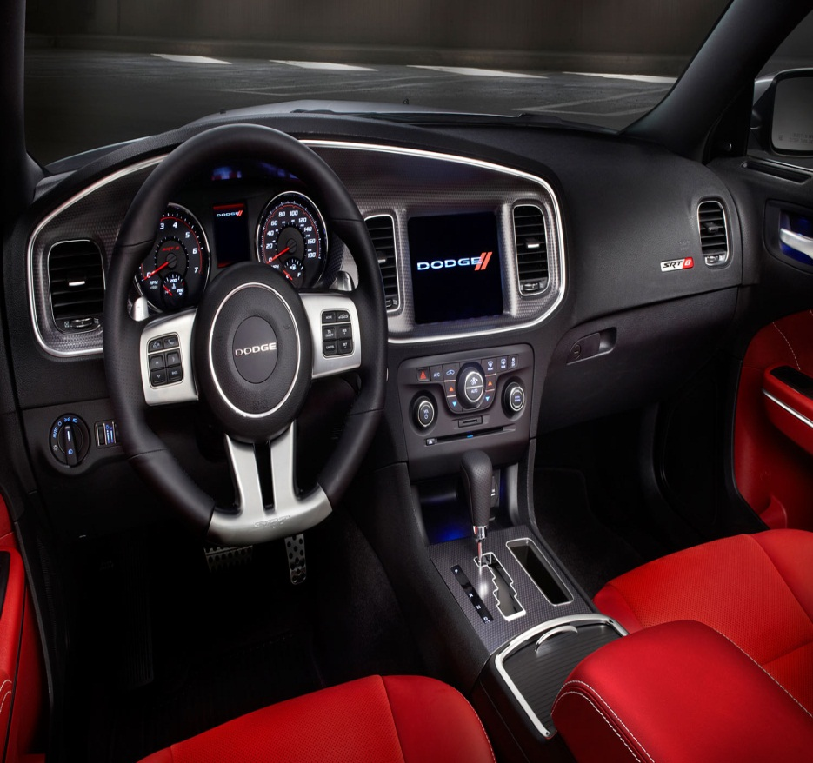
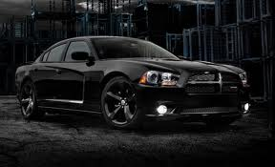
If my best friend were a car, she would be a 2012 SRT8 Dodger Charger, because she’s very stylish.

Slide 3
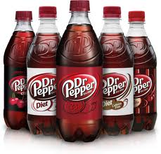
If my best friend were a soft drink she would be Dr. Pepper because everyone likes her.

Slide 4
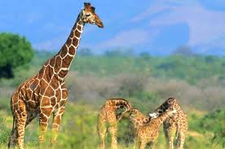
If my best friend were a zoo animal, she would be a Giraffe, because she’s taller than me and she knows I hate it.

Slide 5
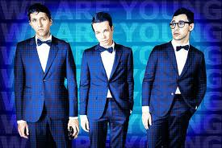
If my best friend were a song, she would be a “We Are Young” by FUN, because she’s carefree about her life and does what she wants, not what people tell her to do.

Slide 6
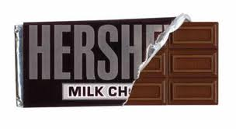
If my best friend were a candy, she would be a Hershey Milk Chocolate, because she’s very creamy……..

