Slide 1
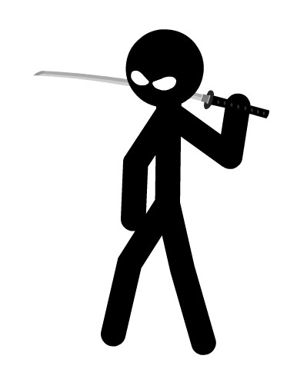
My Best Friend: JERRY
BY MIKE REED

Slide 2
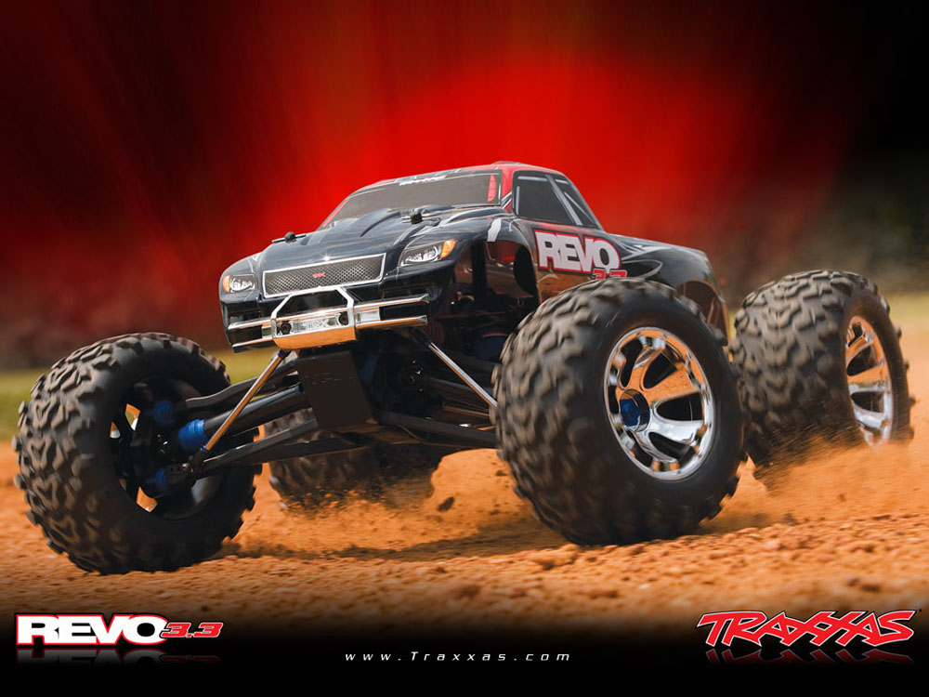
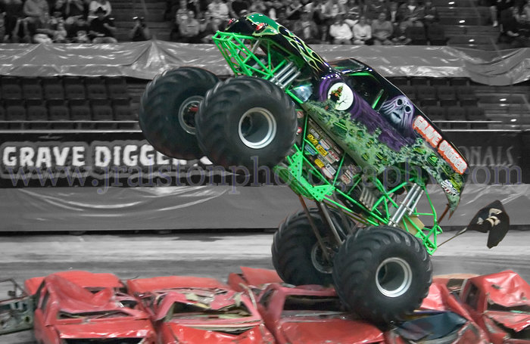
If my best friend were a car, he would be a MONSTER truck because he likes to be ADVENTUROUS.

Slide 3
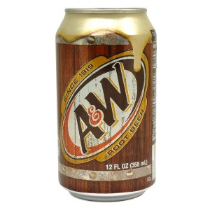
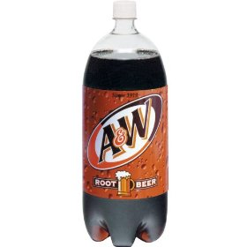
If my best friend were a soft drink…he would be a ROOTBEER because he is rough!!!!

Slide 4
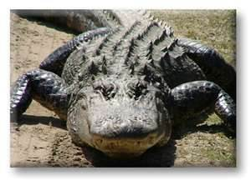
If my best friend were a zoo animal, he would be a ALIGATOR because he loves to wrestle.

Slide 5
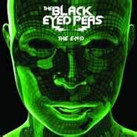
If my best friend were a song, he would be “BOOM BOOM POW” because its fun like him.

Slide 6
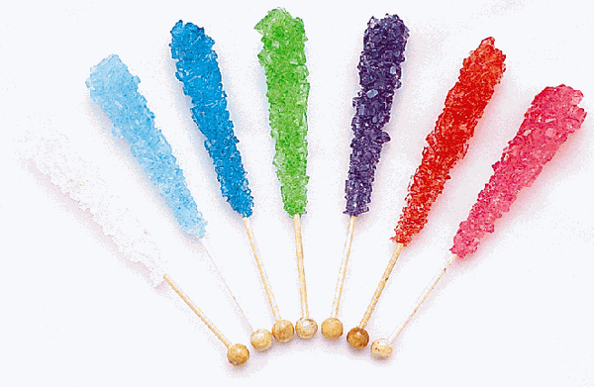
If my best friend were a candy, he would be a ROCK CANDY because he is hard headed!!!!

