Slide 1
My Best brother Rex Watson
-Written by Mia Watson

Slide 2
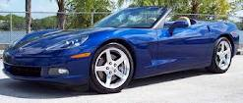
If my brother were a car, he would be a convertible , because he is so cool!

Slide 3
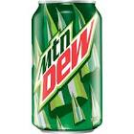
If my brother were a soft drink he would be a mountain dew, because he is crazy!

Slide 4
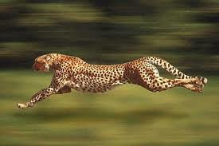
If my brother were a zoo animal, he would be a cheetah , because he is so fast

Slide 5
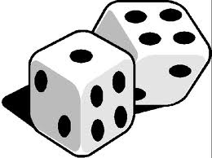
If my brother were a song ,he would be “Roll The Dice”, because he is so active.

Slide 6
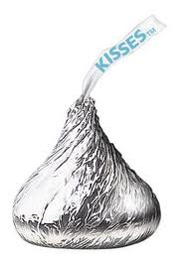
If my brother were a candy, he would be a Hershey kiss, because he is so sweet!

