Slide 1
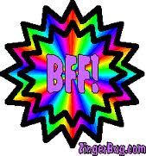
My Best Friend Marly Goodwin
-Written by Mia Watson

Slide 2
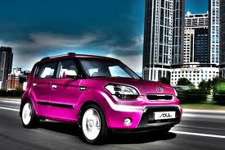
If my best friend were a car, she would be a Kia Soul, because she is so cute!

Slide 3
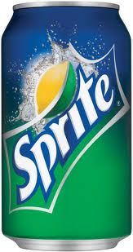
If my best friend were a soft drink she would be a Sprite, because she is like sparkles!

Slide 4
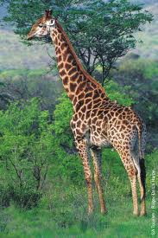
If my best friend were a zoo animal, she would be a giraffe, because she is so beautiful.

Slide 5
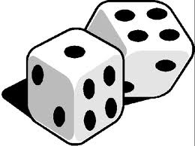
If my best friend were a song ,she would be “Roll The Dice”, because she is so active.

Slide 6
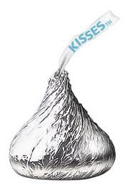
If my best friend were a candy, she would be a Hershey Kiss, because she is so sweet!

