Slide 1
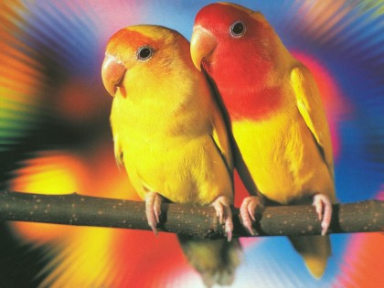
My Best Friend: Zalaa
Written by Maritza Ruiz

Slide 2
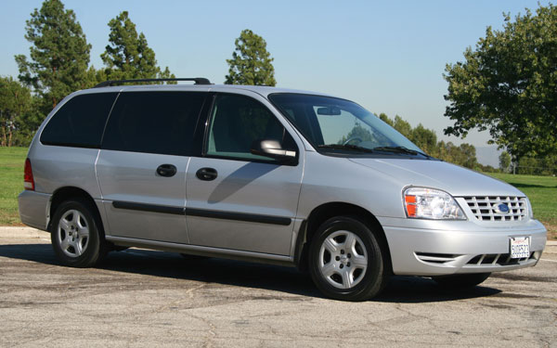
If my best friend were a car, she would be a mini van because lot of people fit.

Slide 3
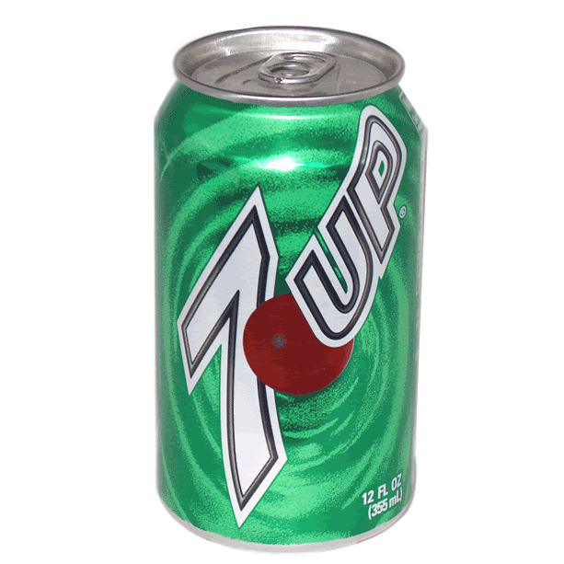
If my best friend were a soft drink she would be a 7up because it’s really sweet.

Slide 4
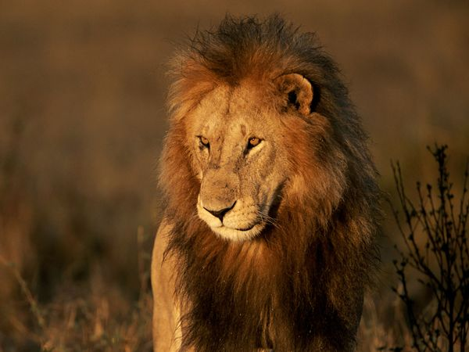
If my best friend were a zoo animal, she would be a lion because she can scare people.

Slide 5
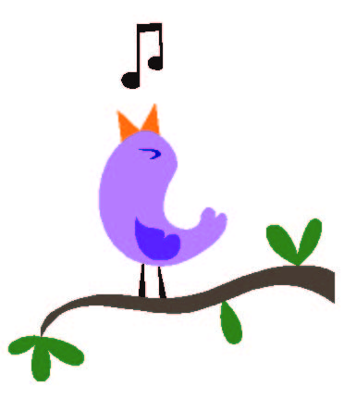
If my best friend were a ringtone, she would be a bird singing because her voice is pretty.

Slide 6
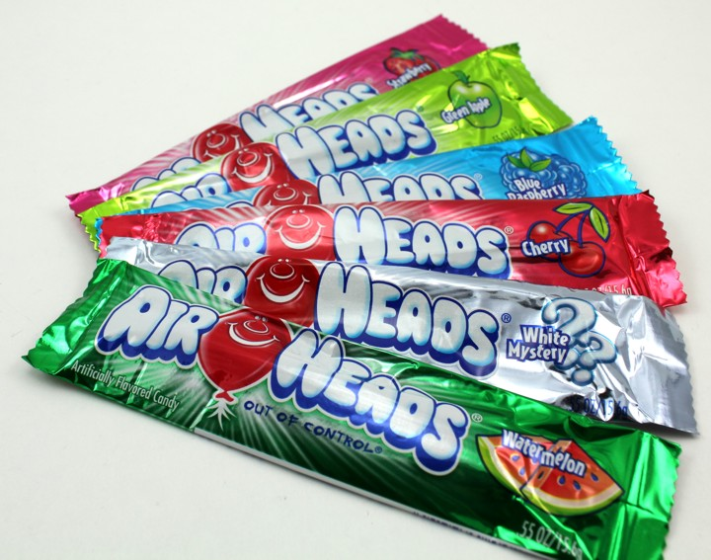
If my best friend were a candy, she would be a airhead because there are different flavors.

