Slide 1
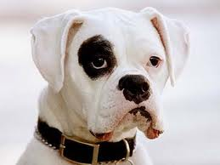
My Best Friend
Alexis
  Written by Mario Hernandez

Slide 2
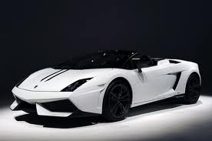
If my best friend were a car, he would be a Lamborghini because he runs fast and is athletic.

Slide 3

If my best friend were a soft drink he would be a Mountain Dew because he is filled with energy.

Slide 4
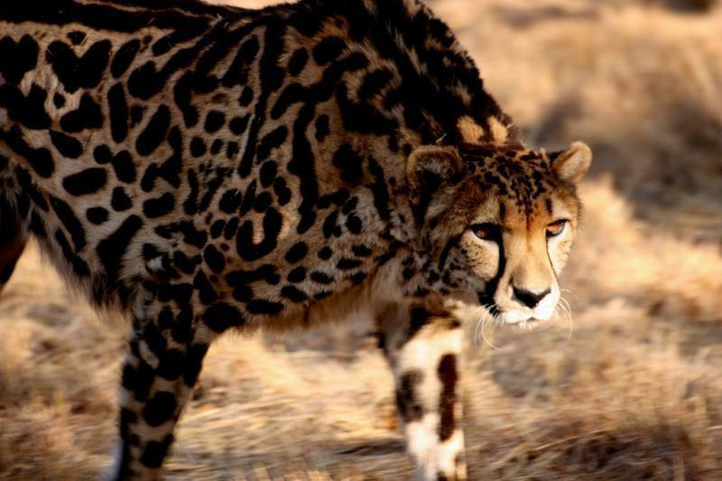
If my best friend were a zoo animal, he would be a cheetah because he is fast.

Slide 5
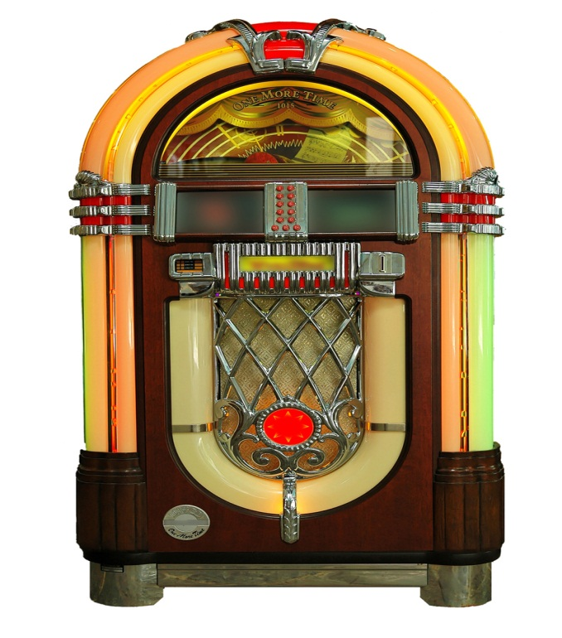
If my best friend were a song, he would be “Sorry For Party Rocking” because sometimes he’s crazy.

Slide 6
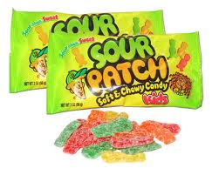
If my best friend were a candy, he would be a Sour Patch Kids because he is sweet.

