Slide 1

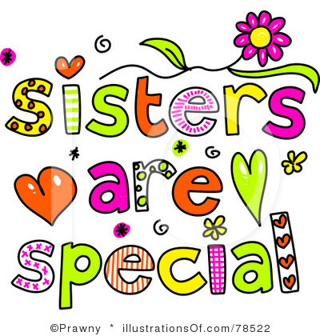
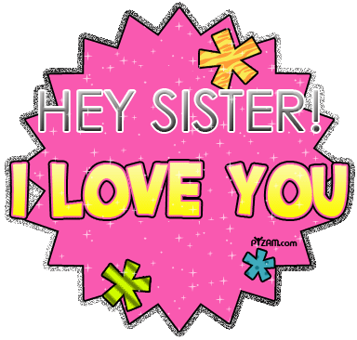

My Best Sister LiA
  Written by Mariana Perez

Slide 2
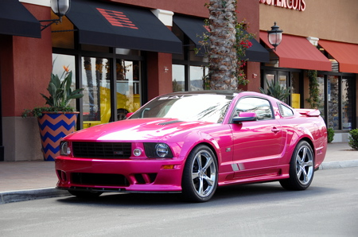
If my sister were a car she would be a Mustang, because she's fast and cute

Slide 3
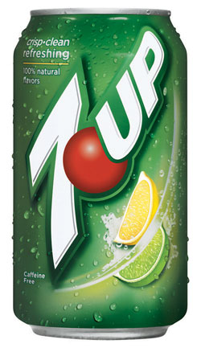
If my sister were a soft drink she would be 7 Up, because she is crisp, clean, and refreshing.

Slide 4
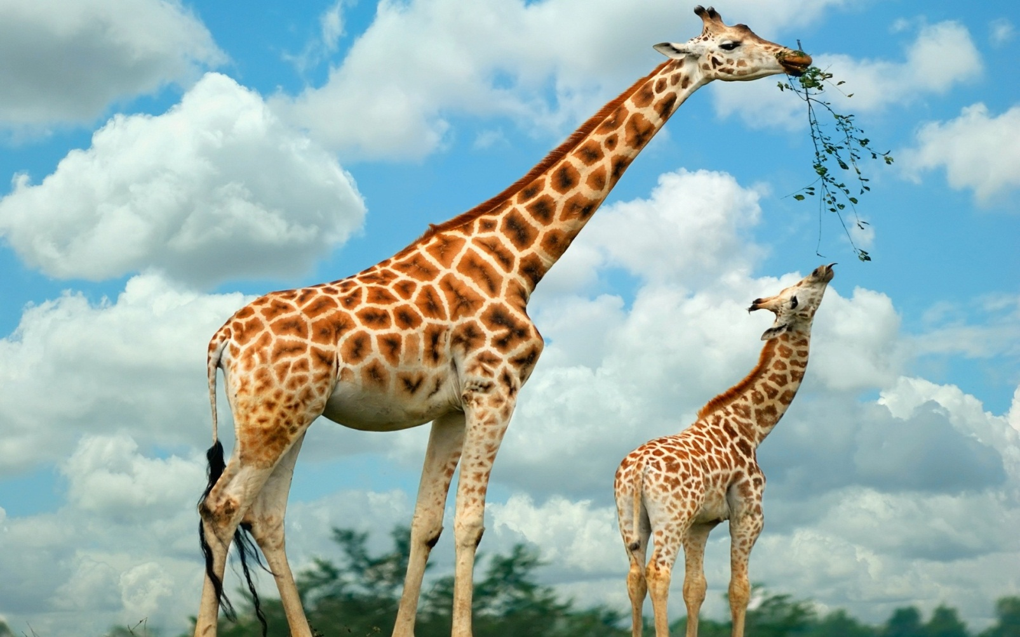
If my sister were a zoo animal she would be a giraffe, because she is friendly.

Slide 5
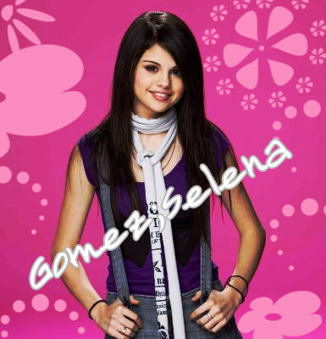
If my sister were a ringtone, she would be “Round and Round,” because she goes around big pole.

Slide 6
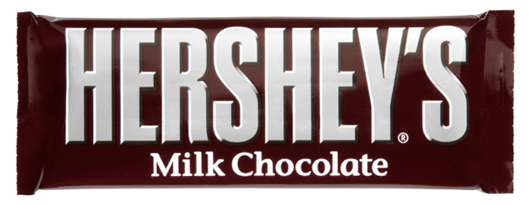
If my sister were a candy she would be a Hershey, because likes chocolate.

