Slide 1
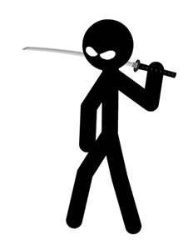
My Best Friend: Michael Reed
Written By Karan Patel

Slide 2
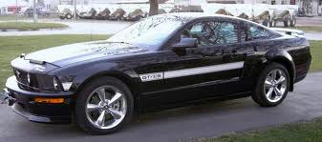
If my best friend were a car, he would be a Mustang, because it’s fast just like my friend.

Slide 3
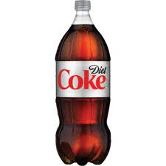
If my best friend were a soft drink he would be a Diet Coke because it is refreshing.

Slide 4
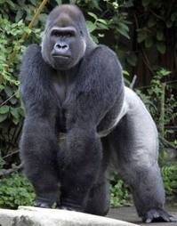
If my best friend were a zoo animal, he would be a gorilla because gorillas are strong just like my friend.

Slide 5
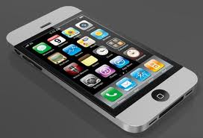
If my best friend were a song, he would be a “Call Me Maybe,” because it is a soft song because he is nice and caring.

Slide 6
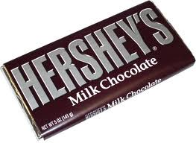
If my best friend were a candy, he would be a Hershey’s bar, because it gives him extra energy.

