Slide 1
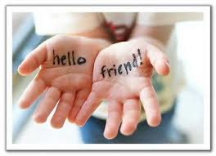
My Best Friend Michael Reed
Written by Jerry Walser

Slide 2
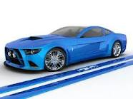
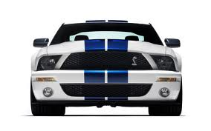
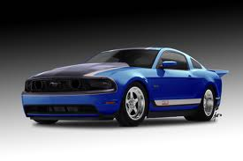
If my best friend were a car, he would be a Mustang, because he is fast & wild.

Slide 3
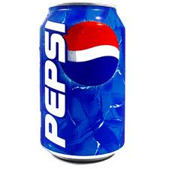
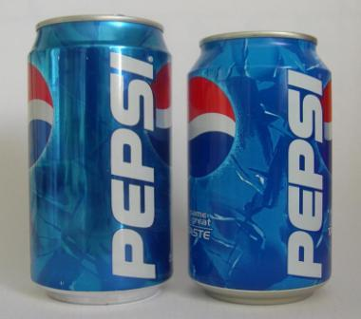
If my best friend were a soft drink…he would be a Pepsi, because he is hyper, energetic & unpredictable.

Slide 4
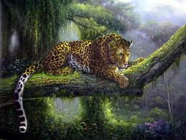
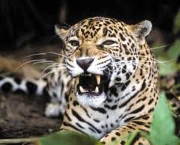
If my best friend were a zoo animal, he would be a jaguar, because as I said he is fast and wild.

Slide 5
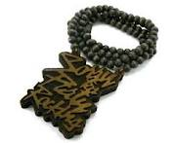
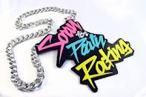
If my best friend were a ringtone, he would be “Sorry for Party Rockin” because he is a super spaz and ready for anything.

Slide 6
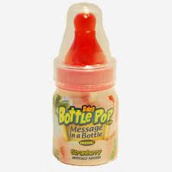
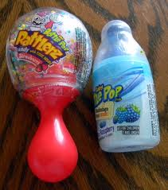
If my best friend were a candy, he would be a Bottle Pop, because he is full of energy.

