Slide 1
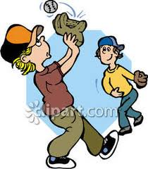
My Best Friend Logan Quan
Written by Jackson Brunn

Slide 2
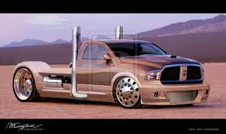
If my best friend were a car, he would be a Ram Truck because he likes sports and is not afraid to get dirty.

Slide 3
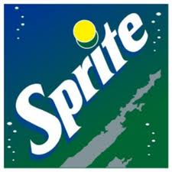
If my best friend were a soft drink he would be a Sprite because he’s sporty and energetic.

Slide 4
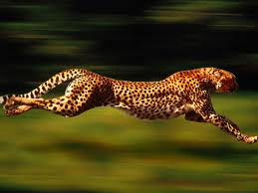
If my best friend were a zoo animal, he would be a cheetah because he’s full of energy.

Slide 5
If my best friend were a song, he would be “Every Day I’m Shufflin” because he likes to party.

Slide 6
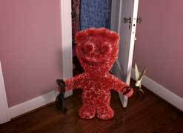
If my best friend were a candy, he would be a Sour Patch because he’s sweet and crazy.

