Slide 1
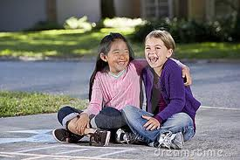
My Best Friend Lani
Written
By
Ilaria Pantano

Slide 2
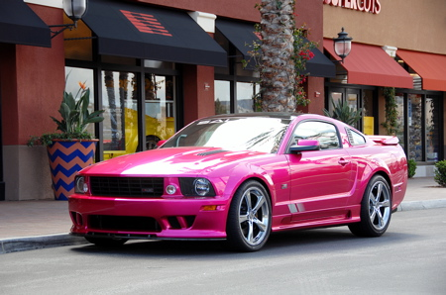
If my best friend were a car, she would be a Mustang because it is fast and strong like her.

Slide 3
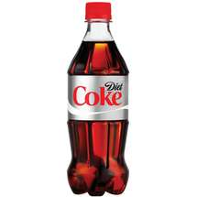
If my best friend were a soft drink she would be a Diet Coke because it is cold and refreshing.

Slide 4
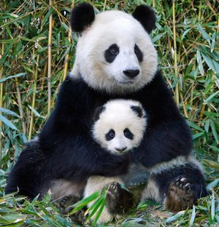
If my best friend were a zoo animal, she would be a panda because it is cute and cuddly , we both love this animal.

Slide 5
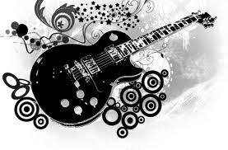
If my best friend were a ringtone, she would be “Pay Phone” because when ever she comes to my house we listen to this song.

Slide 6
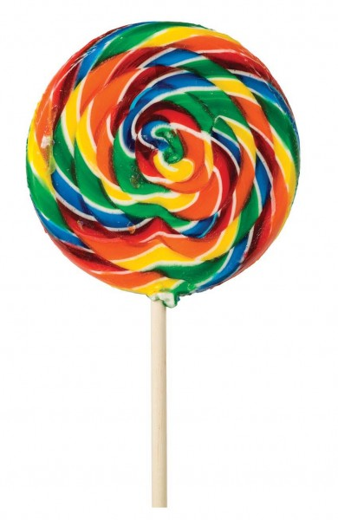
If my best friend were a candy, she would be a rainbow lollypop because it is sweet like her .

