Slide 1
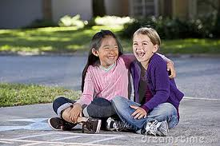
My Best Friend: Kerren
Written by:
Giulia Pantano

Slide 2
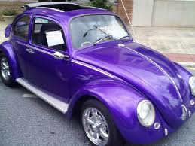
If my best friend was a car it would be a Vosewaggon because they are tiny and it don’t need a lot of gas.

Slide 3
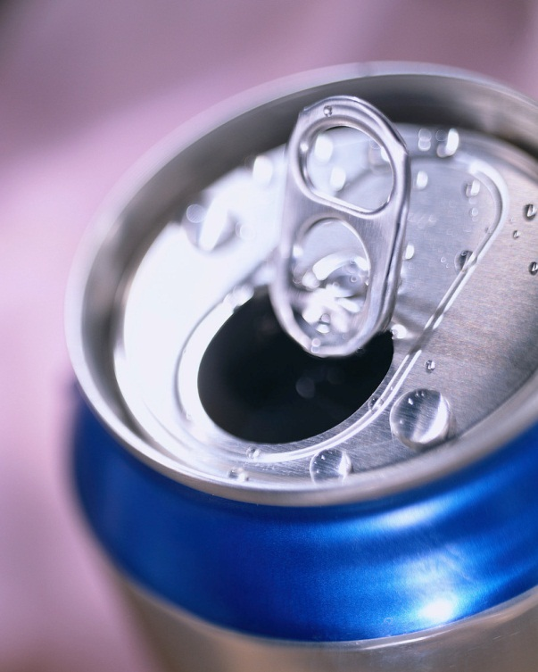
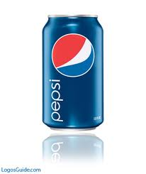
If my best friend was a soft drink, it would be a Pepsi because it is refreshing.

Slide 4
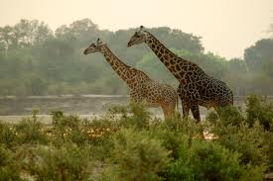
If my friend were a zoo animal, it would be a giraffe, because they are tall, just like me!

Slide 5
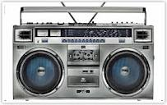
If my best friend were a song, it would be “We are young” by Glee because it is full of good voices.

Slide 6
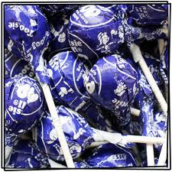
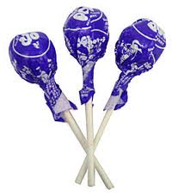
If my friend were a candy, it would be a grape tootsie lollypop because it is sweet like my friend.

