Slide 1
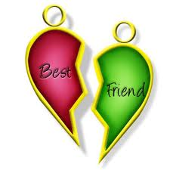
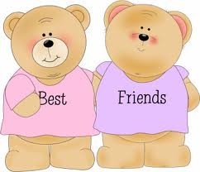
My Best Friend: Ramneet Kaur
Written by
Gabriela Grijalva

Slide 2
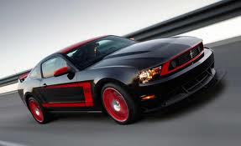
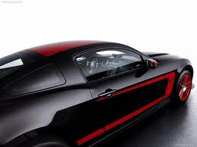
If my best friend were a car, she would be a Mustang because , she’s fast and strong.

Slide 3
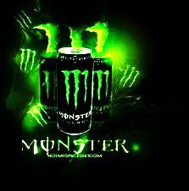
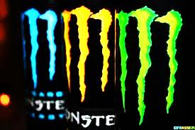
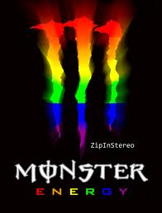
If my best friend were a soft drink she would be a Monster energy drink because, she is full of energy and crazy.

Slide 4
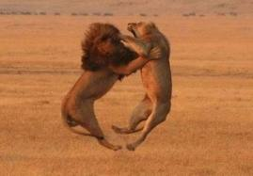
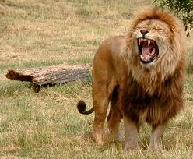
If my best friend were a zoo animal, she would be a lion because, she’s mean and she fights a lot.

Slide 5
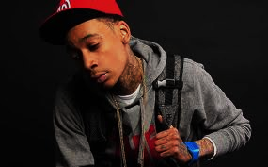
If my best friend were a ringtone, she would be a (young, wild, and free) by Wiz Khalifa because she’s young and she’s always wild and she’s free to do anything she wants.

Slide 6
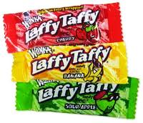
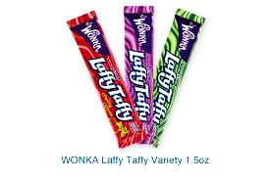
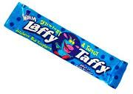
If my best friend were a candy, she would be a Laffy Taffy because she’s twisted.

