Slide 1
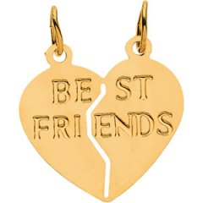
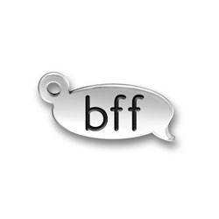
My Best Friend: Vina Young
Written By:
Gabbi Sansoni

Slide 2
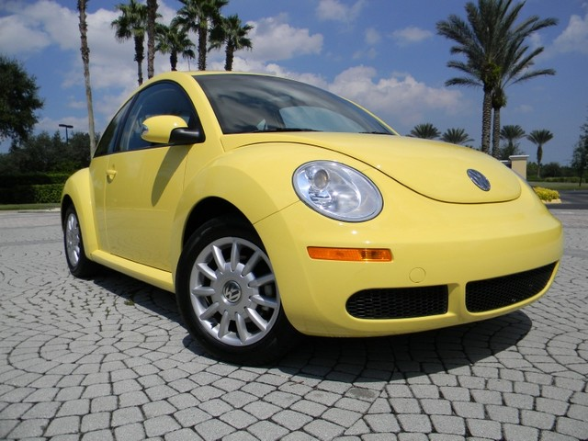
If my best friend were a car, she would be a yellow Slug Bug because she is always bright and happy!

Slide 3
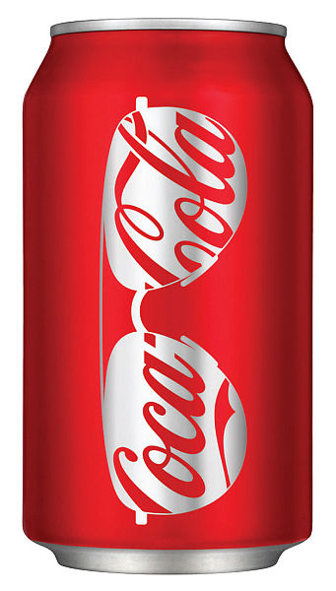
If my best friend was a soft drink she would be a can of Coke because she likes to be crazy!

Slide 4
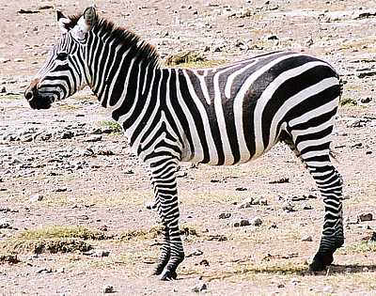
If my best friend was a zoo animal she would be a zebra because she has sense of style.

Slide 5
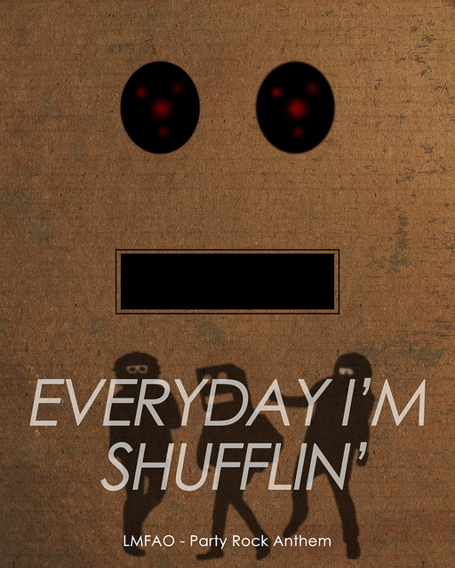
If my best friend was a song she would be “Party Rock Anthem” because she likes to go to parties.

Slide 6
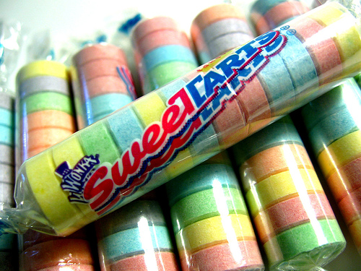
I my best friend was a candy she would be a Sweet Tart because she is very sweet and also very exited.

