Slide 1
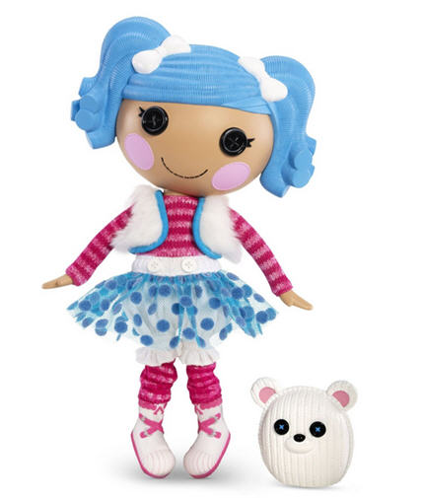
My Best Friend Guliyana
Written by Ethan Harris

Slide 2
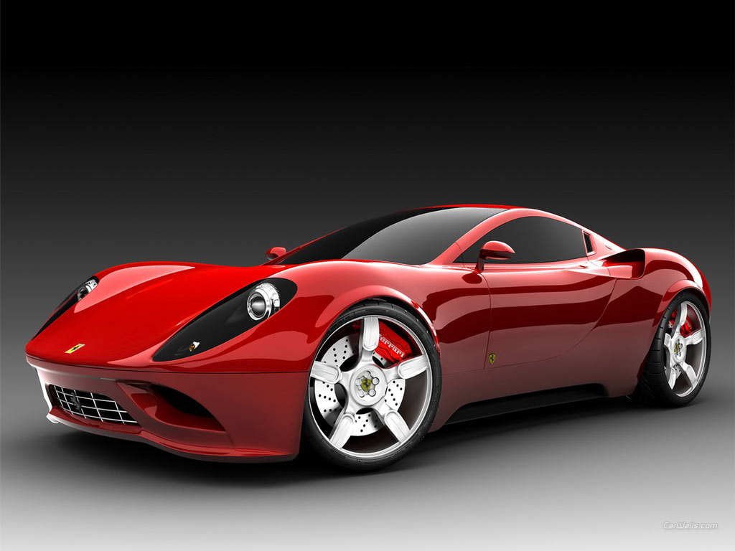
If my best friend were a car, she would be a Ferrari because she super fast.

Slide 3
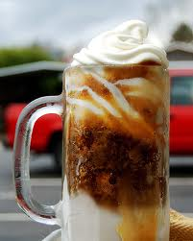
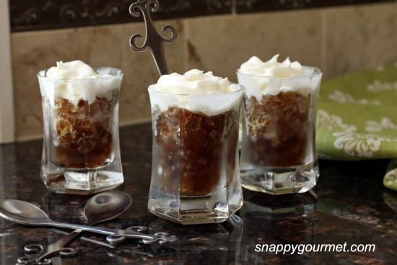
If my best friend were a soft drink, she would be a root beer because she makes me feel better when I’m upset.

Slide 4
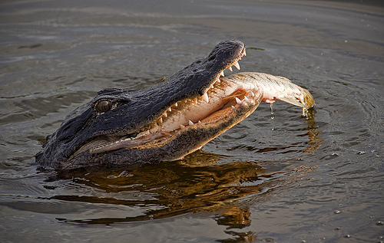
If my best friend were a zoo animal, she would be an alligator because it eats fish and she likes fish.

Slide 5
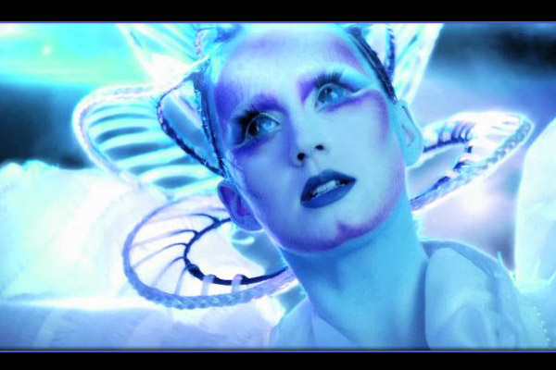
If my best friend were a song, she would be E.T. by Katy Perry because it makes me happy and makes me dance.

Slide 6
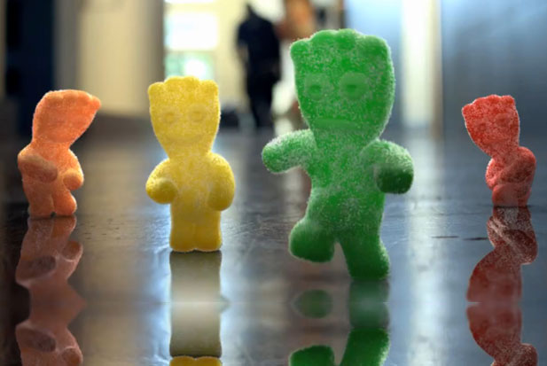
If my best friend were a candy, she would be a Sour Patch Kid because she colorful and fun and sweet.

