Slide 1
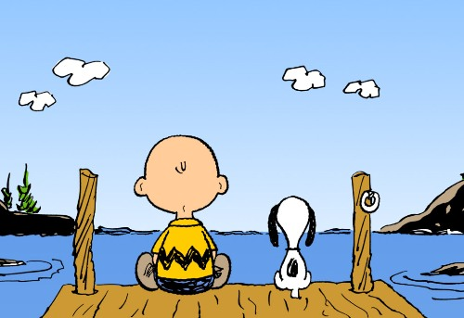
My Best Friend: Nic Merz
Written By
Erick Enriquez

Slide 2
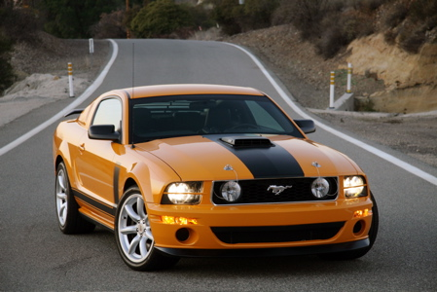
If my best friend were a car, he would be a Mustang because he’s really fast.

Slide 3
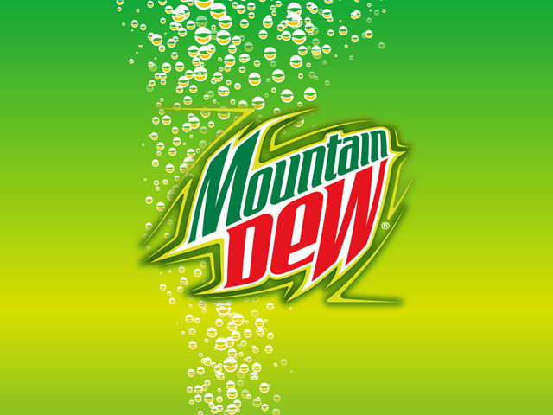
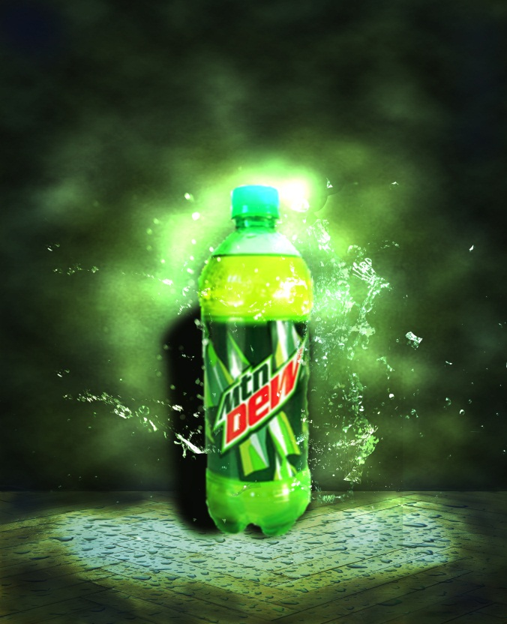
If my best friend were a soft drink, he would be a Mountain Dew because he is very energetic.

Slide 4
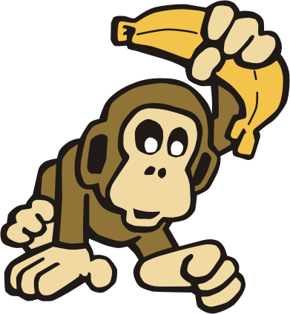
If my best friend were a zoo animal, he would be a monkey because he is very playful.

Slide 5
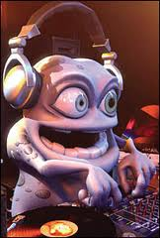
If my best friend were a ringtone, he would be a Crazy Frog ringtone because he’s hard to understand because he talks too fast.

Slide 6
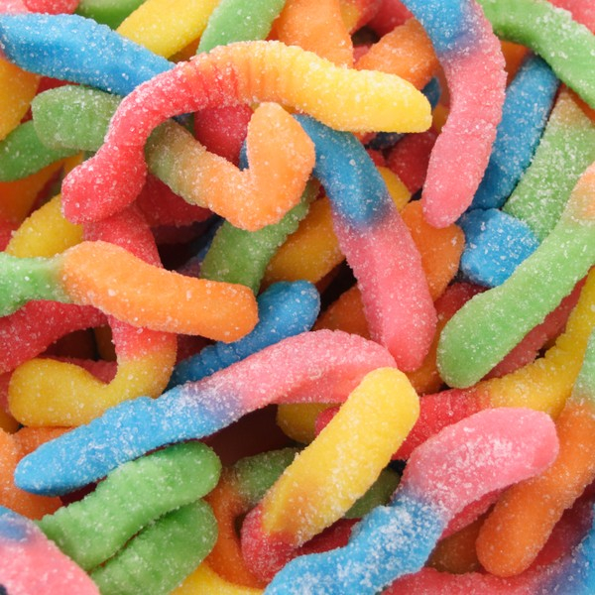
If my best friend were a candy, he would be a Sour Gummy Worm because he’s kind of sour and kind of sweet.

