Slide 1
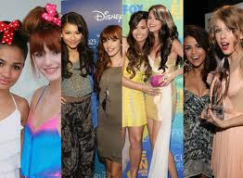
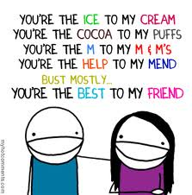
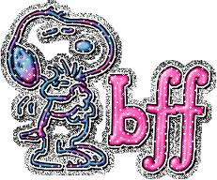
My Best Friend: Marissa Soza
Written by Emma McLarty

Slide 2
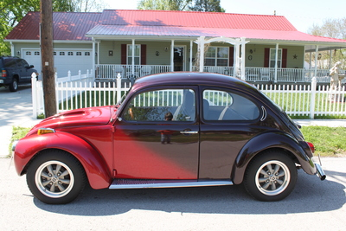
If my best friend were a car she would be an VW Bug, because she is cute like me!

Slide 3
If my best friend were a soft drink she would be a 7 up, because it makes her laugh.

Slide 4
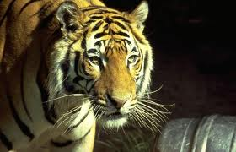
If my best friend were a zoo animal she would be a tiger, because she can be very sneaky.

Slide 5
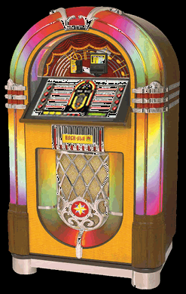
If my best friend were a song she would be “Baby,” because she loves Justin Bieber songs and his voice.

Slide 6
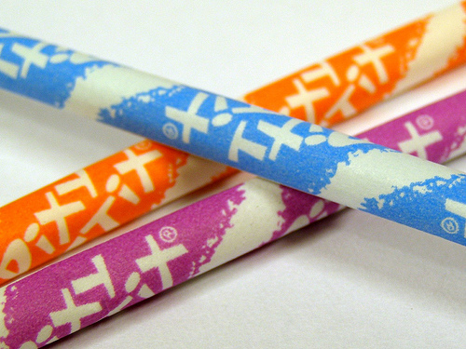
If my best friend were a candy, she would be a Pixy Stick, because she is sour!

