Slide 1
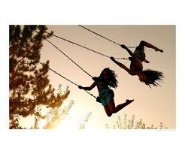
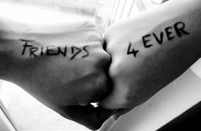
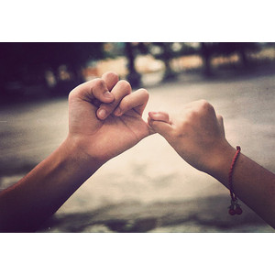
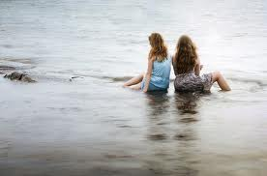
My Best Friend Erica Gomez
Written by Diana Duarte

Slide 2
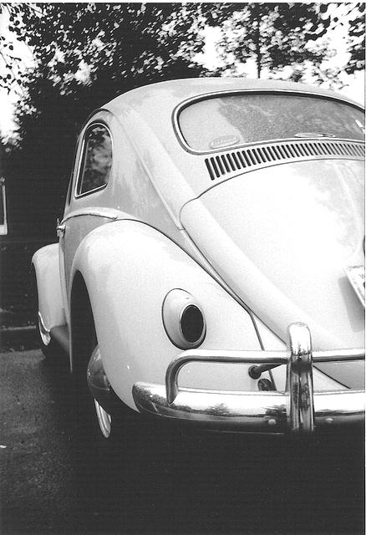
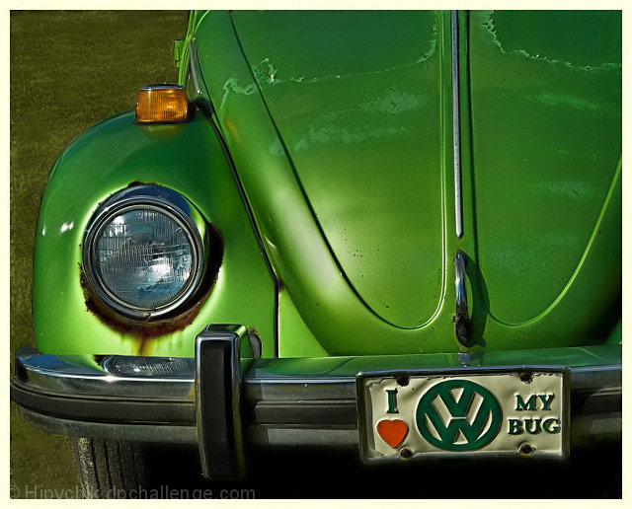
If my best friend were a car, she would be a slug bug because she's the bests ever and she's nice and sweet.

Slide 3
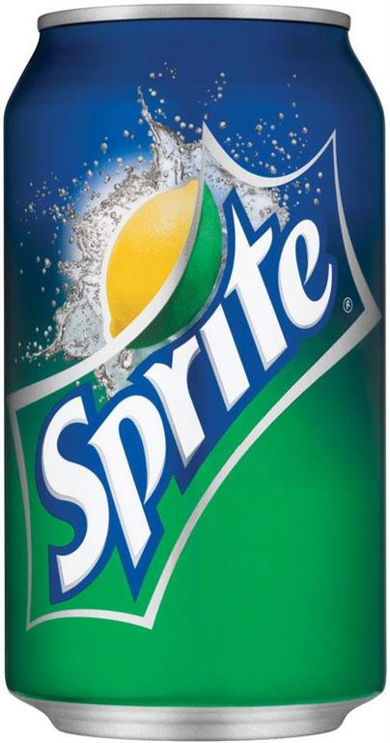
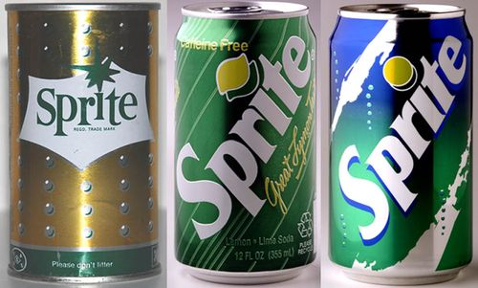
If my best friend were a soft drink she would be a Sprit because she sometimes drink at parties.

Slide 4
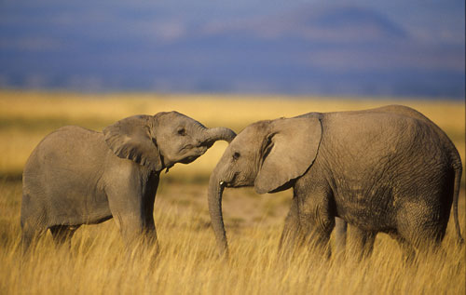
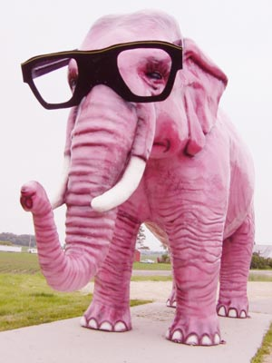
If my best friend were a zoo animal, she would be a elephant because she sprays me with a hose.

Slide 5
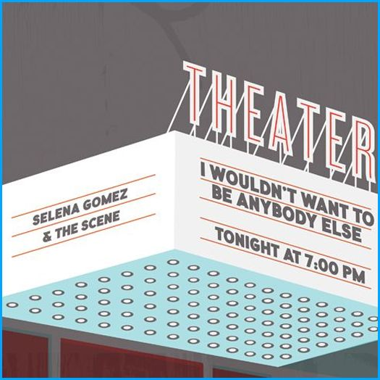
If my best friend were a song she would be a “Who Say” by Selena Gomez because is different and doesn’t care what think about her.

Slide 6
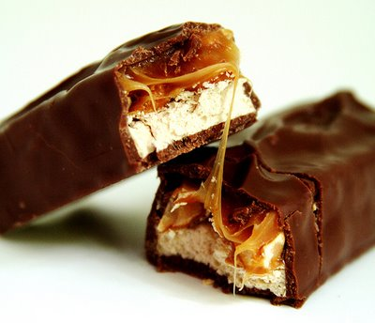
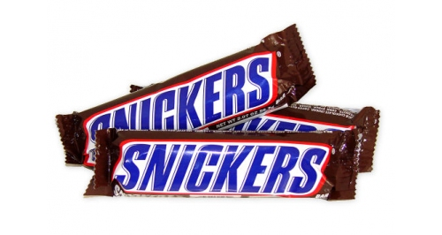
If my best friend were a candy, she would be a Snicker bar because she's is hard on the outside and soft and chewy in the inside.

