Slide 1
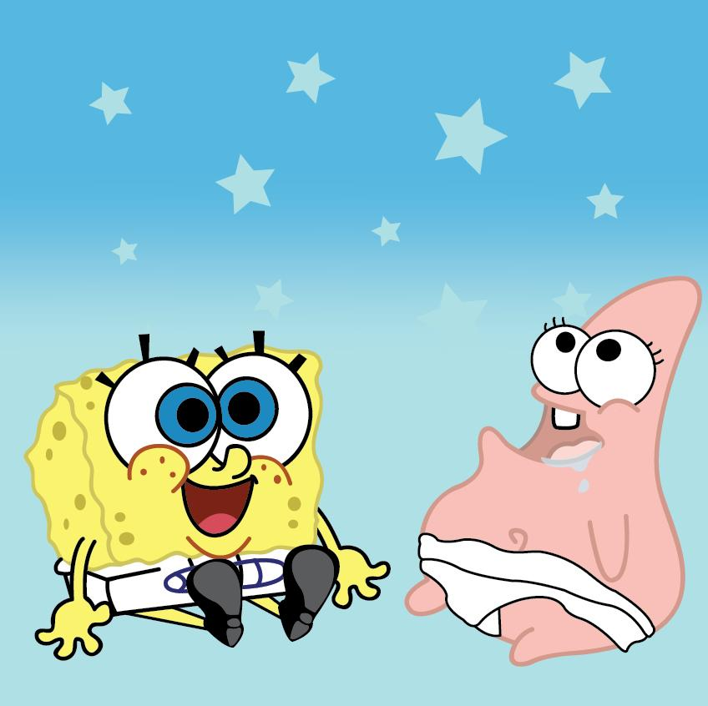
My Best Friend Krys Charles
Written by Deepanshu Singh.

Slide 2
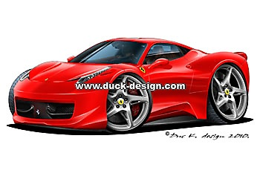
If my best friend were a car, he would be a Ferrari, because he is fast and smooth.

Slide 3
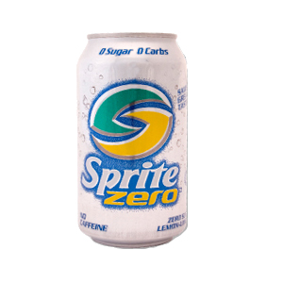
If my best friend were a soft drink he would be a Sprite, because he is sweet and sour.

Slide 4
If my best friend were a zoo animal, he would be a Lion, because he is wild.

Slide 5
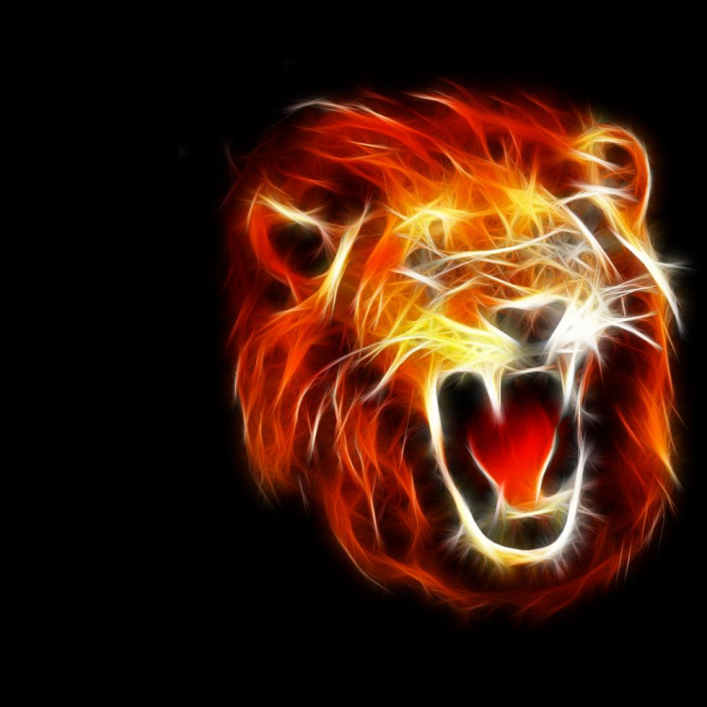
If my best friend were a ringtone, he would be a roar of Lion, because he is loud.

Slide 6
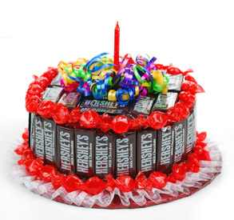
If my best friend were a candy, he would be a candy bar If my best friend were a candy, he would be a Hershey candy bar because he is sweet.

