Slide 1
My Best Friend: Hope Perapoto
Written by Claire Cadiz

Slide 2
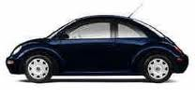
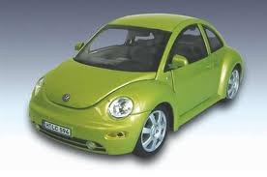
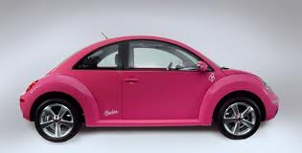
If my best friend were a car, she would be a Volkswagen Bug, fun and playful and ready to go.

Slide 3
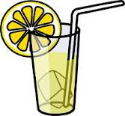
If my best friend were a drink she would be lemonade, soft and tangy and with little surprises everywhere.

Slide 4
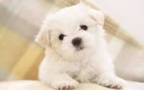
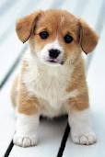
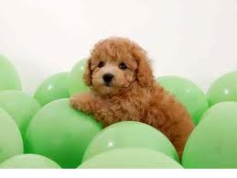
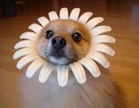
If my best friend were an animal, she would be a puppy, soft, kind and bouncy.

Slide 5
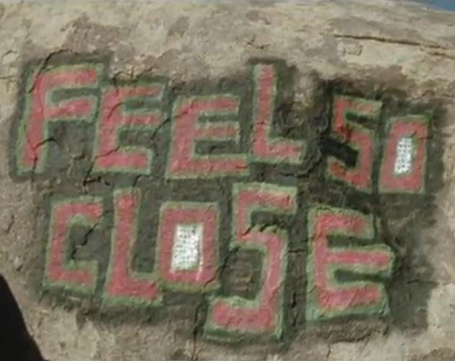
If my best friend were a song she would be “So Close.” That’s her favorite song and it’s a lot like her, soft and dramatic.

Slide 6
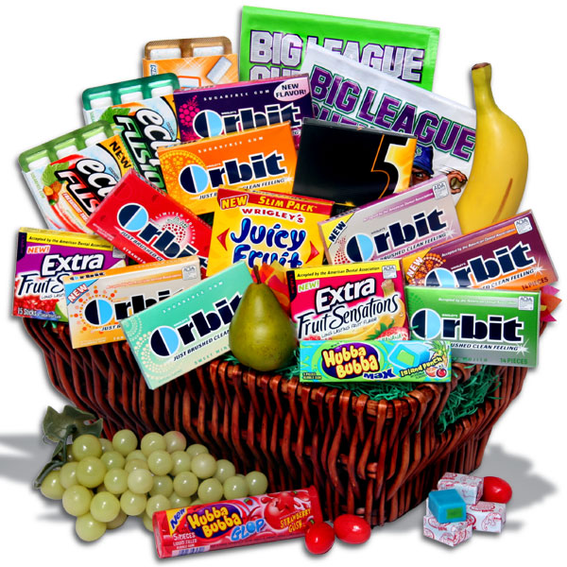
If my best friend were a candy, she would be gum, she is bouncy and has little surprises here and there.

