Slide 1
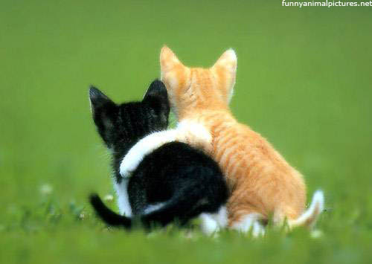
My Best Friend: Celinja romero
Written by
Ayrikha Cavanaugh

Slide 2
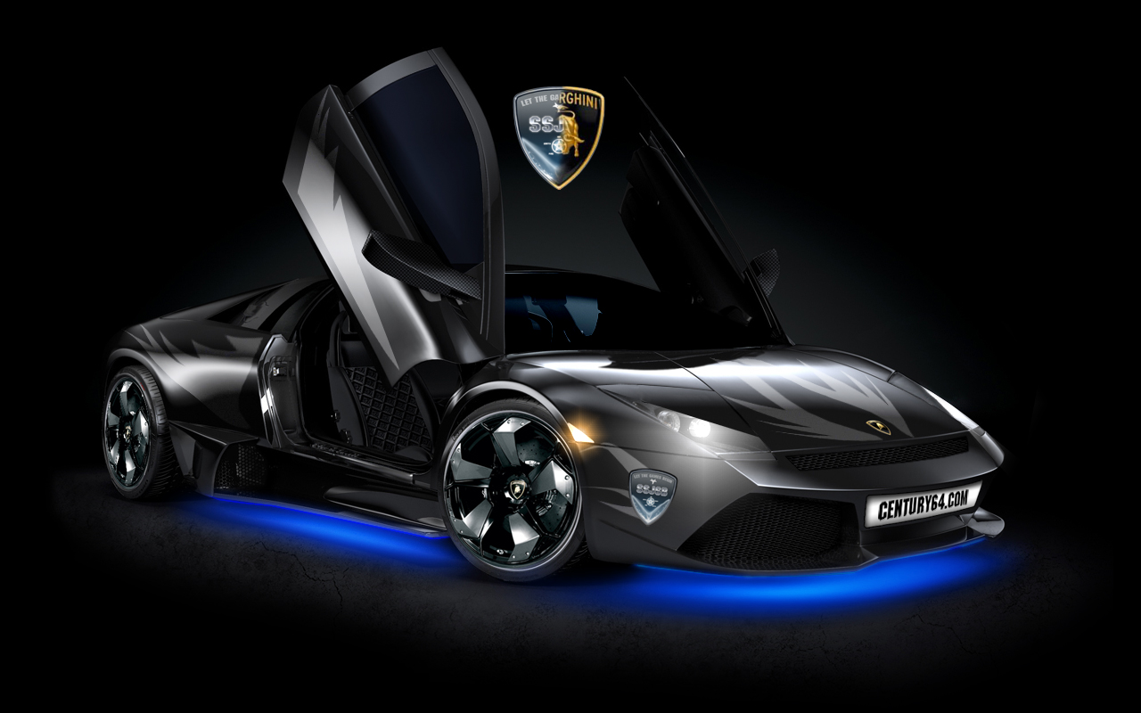
If my best friend were a car, she would be a Lamborghini because she is very fast and expensive.

Slide 3
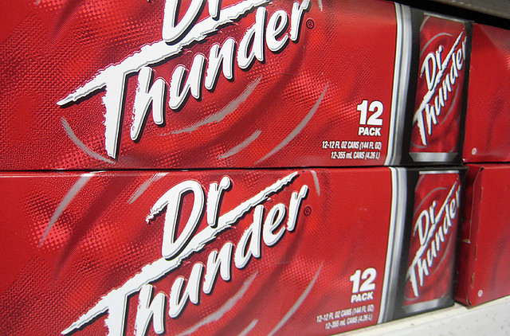
If my best friend were a soft drink she would be a Dr. thunder because she is bubbly.

Slide 4
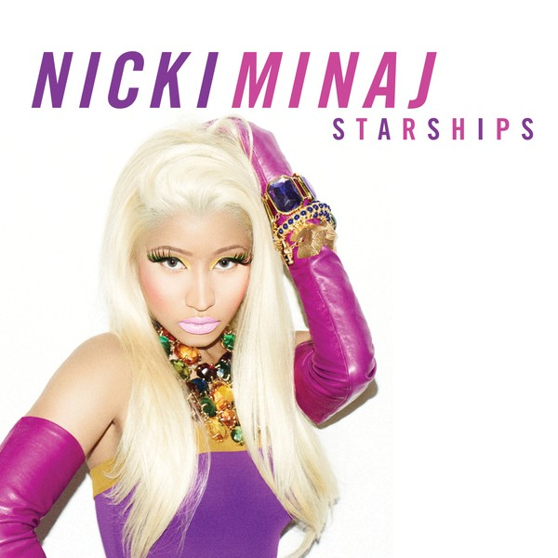
If my best friend were a ringtone, she would be (starships) because she always wanted to fly.

Slide 5
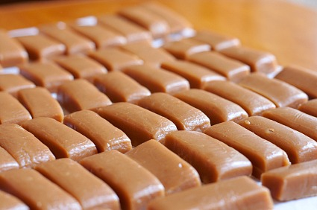
If my best friend were a candy, she would be a Carmel candy because it is very rich and smooth and she is cool .

