Slide 1
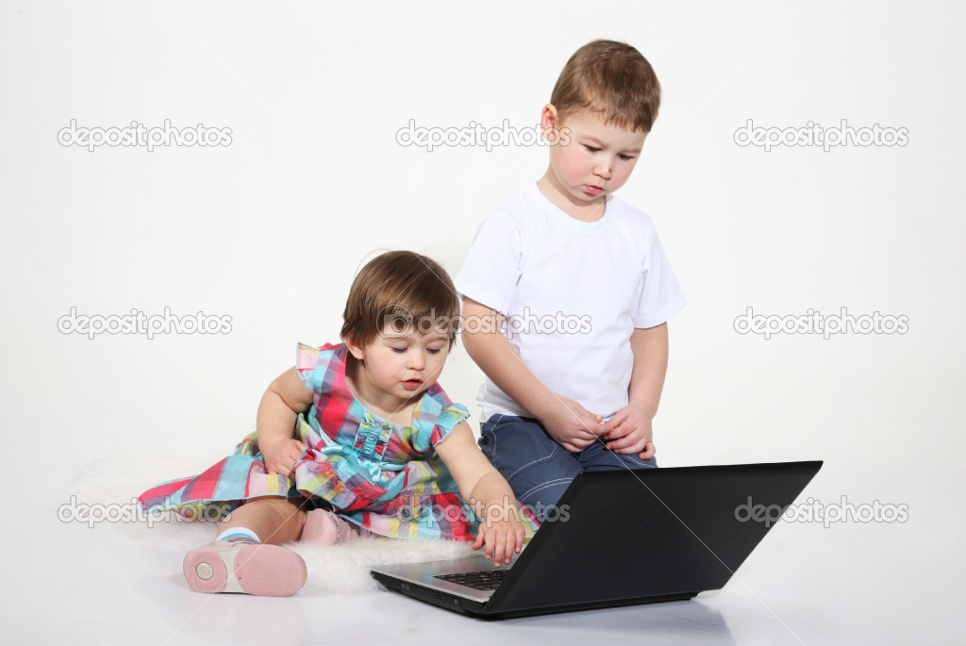
My Best Friend Julian Gosal
Written by Avneet Gosal

Slide 2
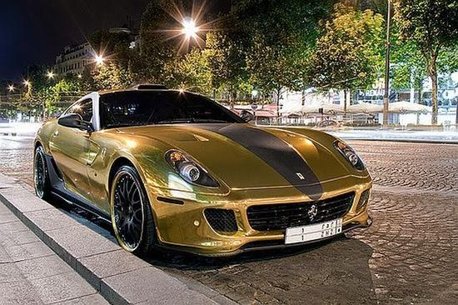
If my best friend were a car, he would be a Ferrari, because he is fast and stylish.

Slide 3
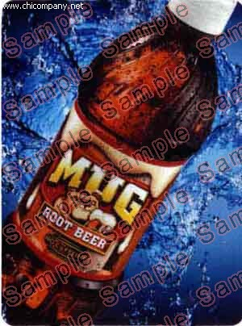
If my best friend were a soft drink he would be a Mug Root Beer, because it tastes good.

Slide 4
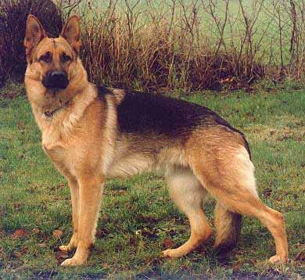
If my best friend were a zoo animal, he would be a dog, because they are so cute and playful.

Slide 5
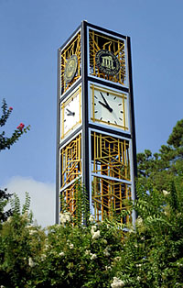
If my best friend were a ringtone, he would be a Bell Tower, because it feels like I`m in London.

Slide 6
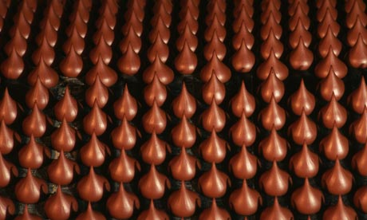
If my best friend were a candy, he would be a Hershey`s kiss because they are yummy.

