Slide 1
My Best Friend: Griffin Dhanota
Written by Avinoor

Slide 2
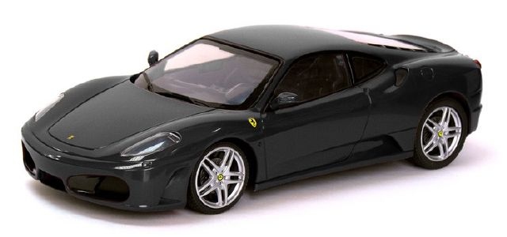
If my best friend were a car, he would be a black car because the color suits him.

Slide 3
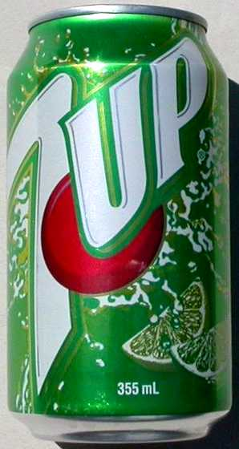
If my best friend were a soft drink he would be a 7 Up because he makes me feel better when I feel down sometimes.

Slide 4
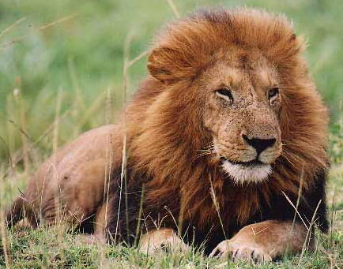
If my best friend were a zoo animal, he would be a lion because he would like to be ferocious.

Slide 5
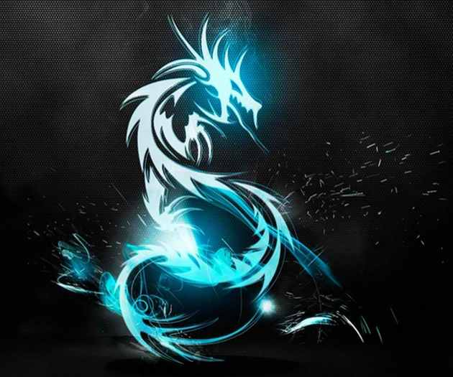
If my best friend were a ringtone he would be a sound of a Dragon because they are fierce.

Slide 6
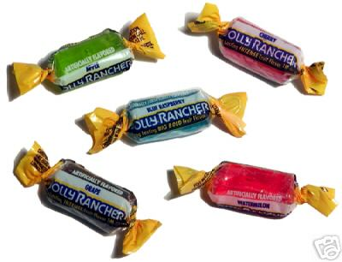
If my best friend were a candy, he would be a Jolly Rancher because he is sweet and sour and he wears different colors of clothes.

