Slide 1
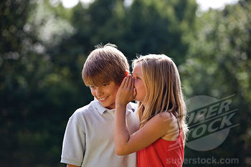
My Best Friend Michael Q.
Written by Ava Dudley

Slide 2
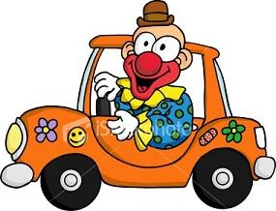
If my best friend were a car, he would be a clown car, because he is funny.

Slide 3
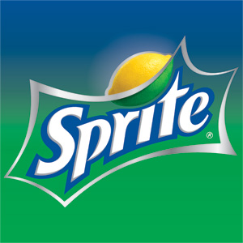
If my best friend were a soft drink…he would be Sprite, because he is kind.

Slide 4
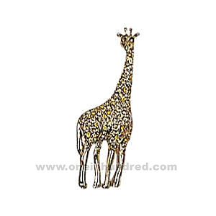
If my best friend were a zoo animal, he would be a giraffe, because he is fun to be with.

Slide 5
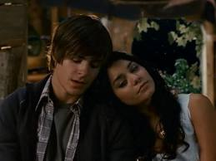
If my best friend were a ringtone, he would be “Right Here, Right Now” because he is kind.

Slide 6
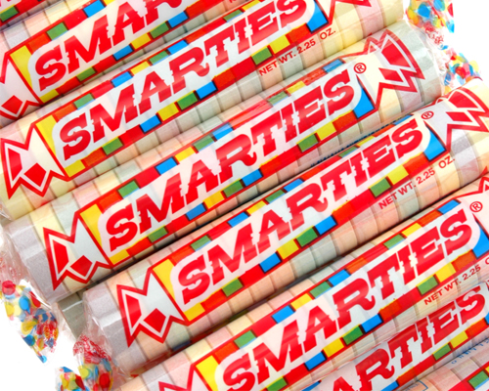
If my best friend were a candy, he would be a smarty because he is smart.

