Slide 1
My Best Friend: Ulises
By: andrew brunn

Slide 2
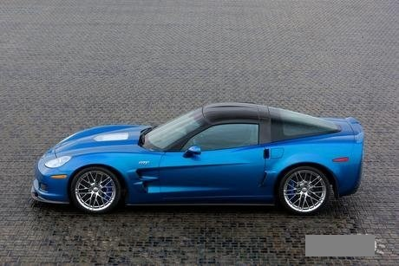
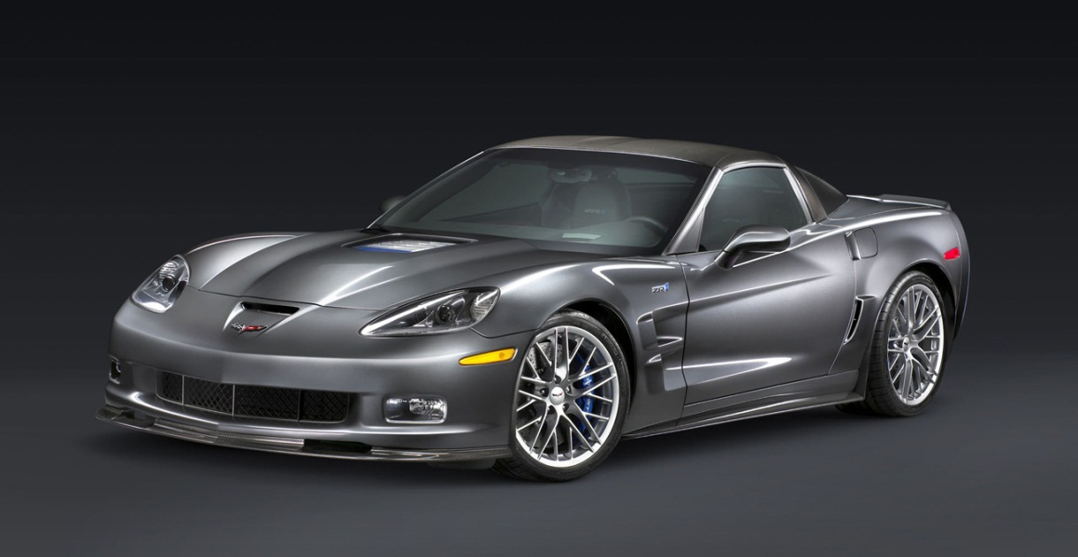
Car If my best friend were a car, he would be Corvette because he has a lot of style.

Slide 3
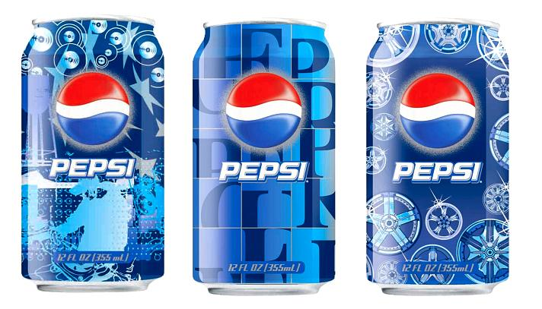
Soft drink If my best friend were a soft drink…he would be a Pepsi because it is cold just like him .

Slide 4
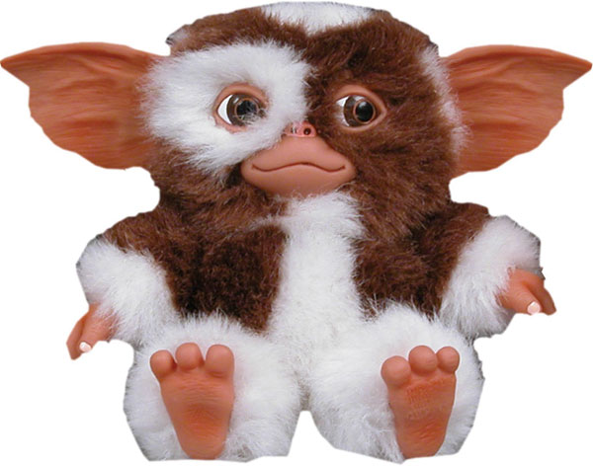
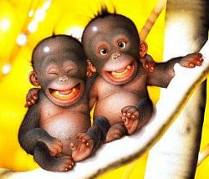
Zoo animal If my best friend were a zoo animal, he would be a monkey. Monkeys have a lot of energy just like him.

Slide 5
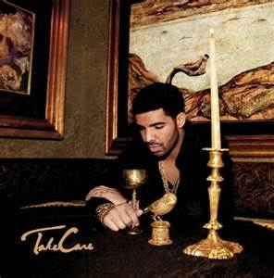
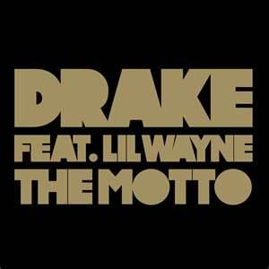
Song If my best friend were a song, he would be “The Motto”. He would be the motto because he has a nice beat.

Slide 6
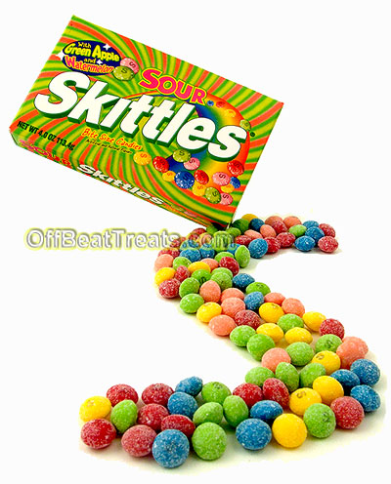
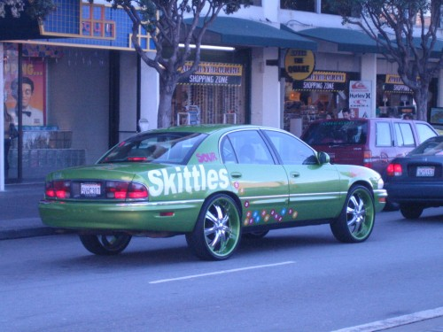
Candy If my best friend were a candy, he would be a Sour Skittle. He would be a sour skittle because he is sweeet.

