Slide 1
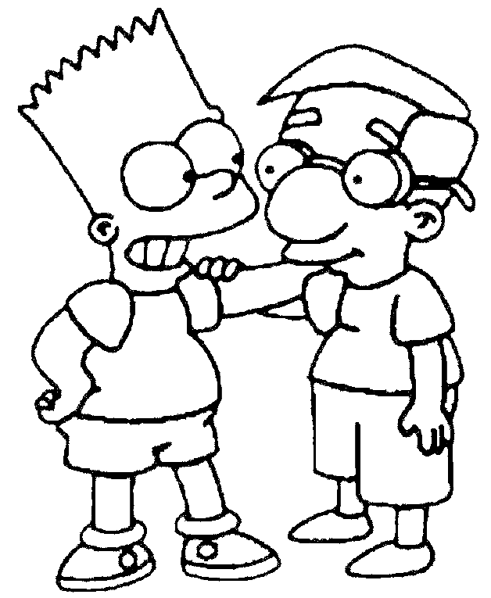
My Best Friend Danny
Written by Alexis Rodriguez

Slide 2
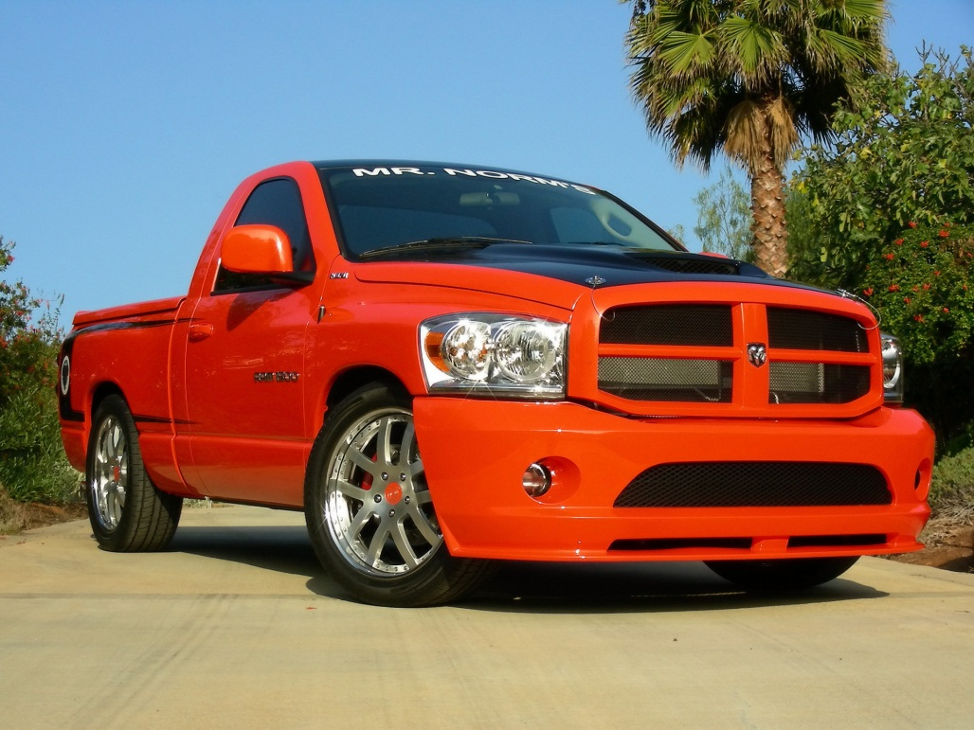
If my best friend were a car, he would be a truck because he runs fast and slow.

Slide 3
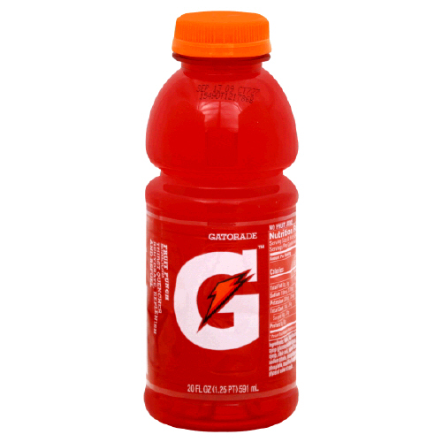
If my best friend were a soft drink he would be Gatorade because he is very energetic.

Slide 4
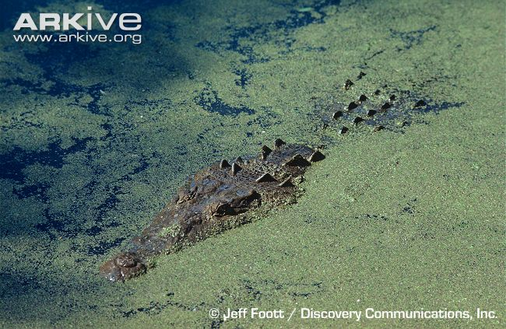
If my best friend were a zoo animal, he would be a crocodile because he likes to swim.

Slide 5
If my best friend were a ringtone, he would be a rock song because he likes to rock.

Slide 6
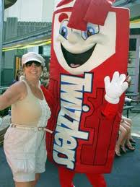
If my best friend were a candy, he would be a twister because he is so hard.

